Slide 1

Predicting customer buying behaviour
20/11/2022

Slide 2
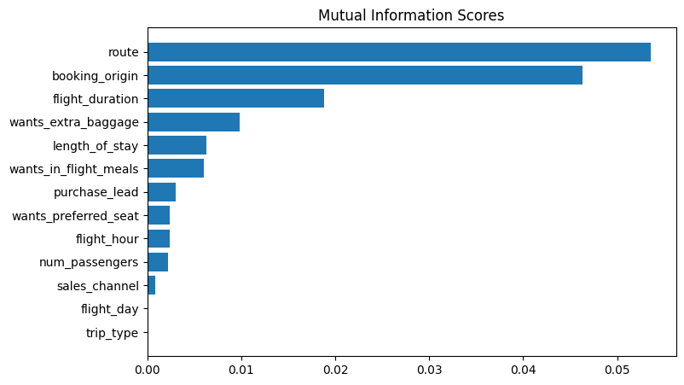
predictive model to understand factors that influence buying behaviour
By Comparing RandomForest and XGBoost, below are the result given by using only top 5 features
Based of this result, we can conclude that
- XGBoost performs better result
- Flight route and origin affects the probability
Of buying tickets
Evaluation | RandomForest | XGBoost
Accuracy | 83.7 | 84.4
ROC_AUC | 0.56 | 0.51

